Slide 1
Form Component
The <Form> component extends the HTML <form> element to provide prefetching of loading UI, client-side navigation on submission, and progressive enhancement.
It's useful for forms that update URL search params as it reduces the boilerplate code needed to achieve the above.
Add link in NAV component
import Link from "next/link";
const Nav = () => {
return (
<div>
<Link href="pages/about"> About </Link> |
<Link href="/"> Home </Link> |
<Link href="/listemp"> ListEmp </Link>|
<Link href="/queryform"> QueryForm </Link>
</div>
)
}
export default Nav

Slide 2
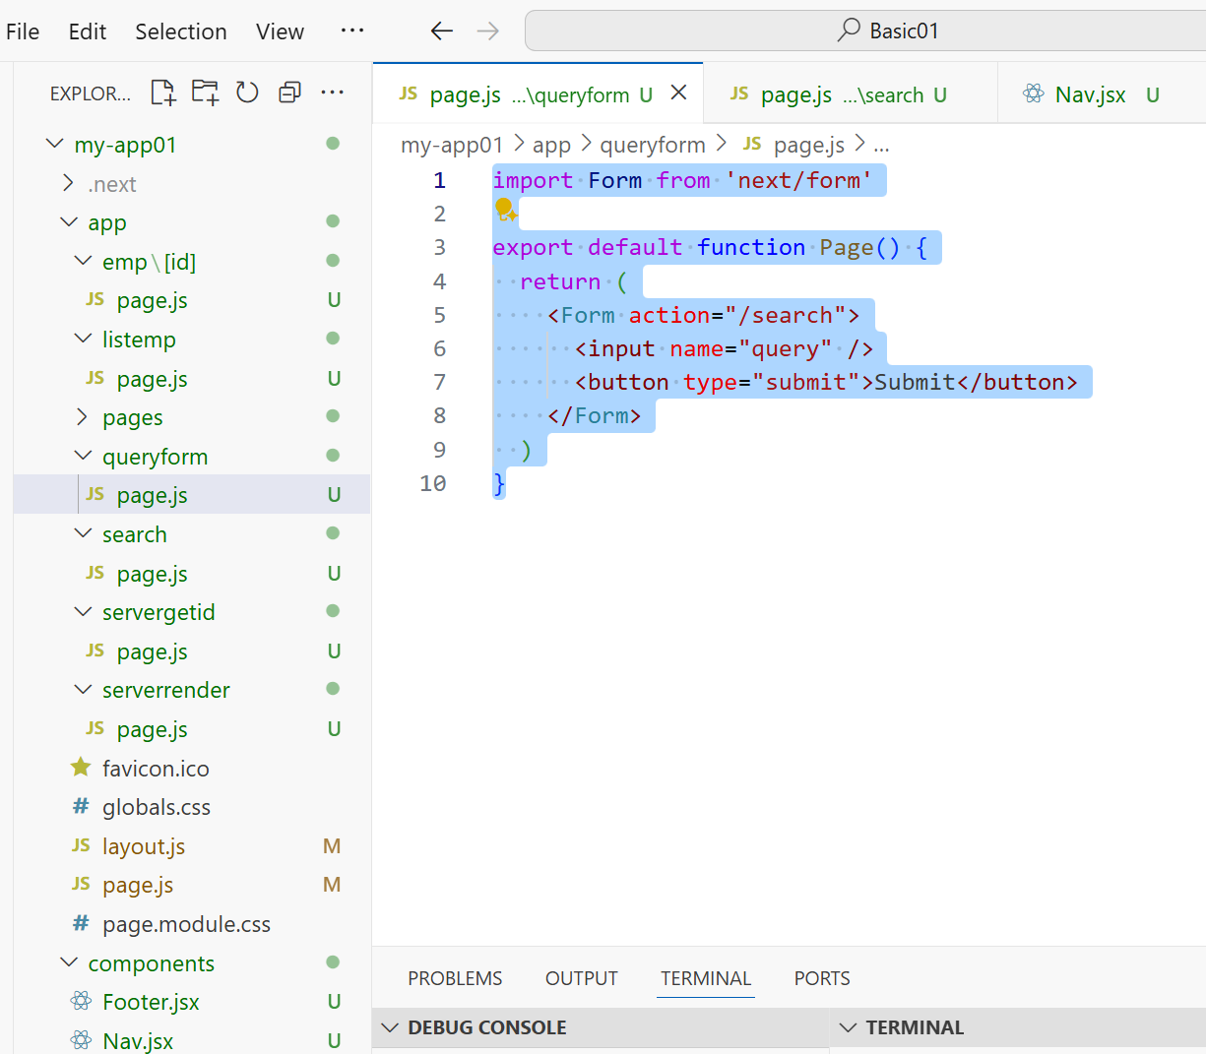
import Form from 'next/form'
export default function Page() {
return (
<Form action="/search">
<input name="query" />
<button type="submit">Submit</button>
</Form>
)
}

Slide 3
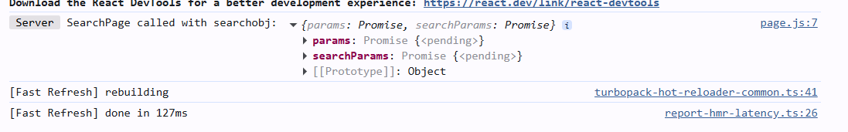
async function getSearchResults(id)
{
return await fetch(`http://localhost:5221/api/Employee/${id}`)
}
export default async function SearchPage(q)
{
console.log("SearchPage called with searchobj:", q);
const searchParams = await q.searchParams;
try{
const res = await getSearchResults((searchParams).query)
if (!res.ok)
throw new Error("Failed to fetch employee data");
const employee = await res.json();
return (
<div><label>Id:</label>
{employee.id}<br />
<label>name:</label>
{employee.name}<br />
<label>Email:</label>
{employee.email}<br />
<label>Dpartment:</label>
{employee.department}
</div>
);
}
catch (error) {
console.error("Error fetching employee data:", error);
return <p>Failed to load employee data.</p>;
}
}
Create a folder search and then create a file page.js file and put this code

Slide 4
import { redirect } from 'next/navigation'
async function createPost(formData) {
'use server'
let demo = {
name: formData.get('name'),
email: formData.get('email'),
department: formData.get('department'),
};
fetch("http://localhost:5221/api/Employee", {
method: 'POST',
headers: { 'Content-type': 'application/json' },
body: JSON.stringify(demo)
}).then(r => { console.log(r) })
console.log('Form data:', demo)
redirect(`/listemp`)
}
export default function Page()
{
return ( <div>
<pre>
<form action={createPost}>
<label>Name:</label>
<input type="text" name="name" required placeholder="Enter your name"/>
<br />
<label>Email:</label>
<input type="text" name="email" required placeholder="Enter your Email"/>
<br />
<label>Department:</label>
<input type="text" name="department" />
<br />
<button type="submit">Create Post</button>
</form>
</pre> </div>
);
}
POST

